Slide 1
Quiz();
Team Members :
Vamsee Krishna Bongu : C0740053
Vinodh Chekuri : C0740001
Akhilesh Chereddy : C0740052
Bharath Reddy Kolli : C0737603
Ram Karnati : C0739482

Slide 2
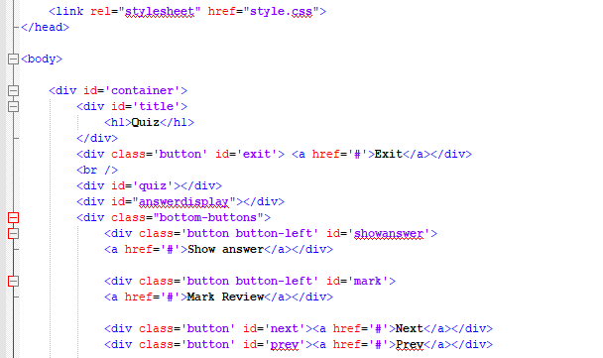
HTML :
Tags Used :
SRC ( for JavaScript)
DIV
Button ( Answer , Next,
Prev, Exit)

Slide 3
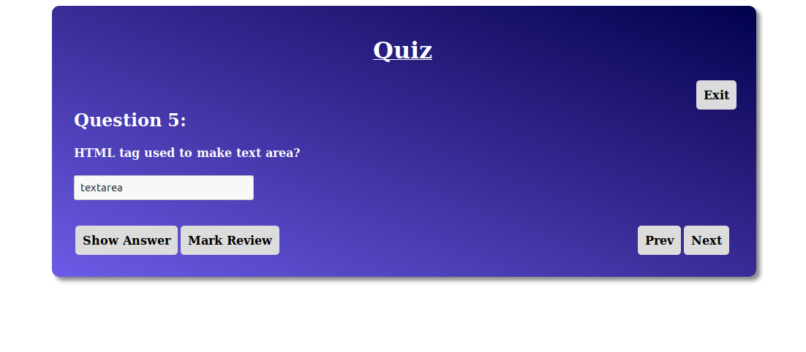

Slide 4
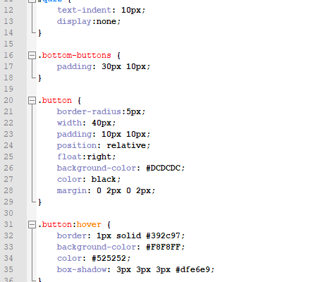
CSS :
Properties Used :
Button:Hover
Container ( Layout )
background-image: linear-gradient
body { font-family: arial; }

Slide 5
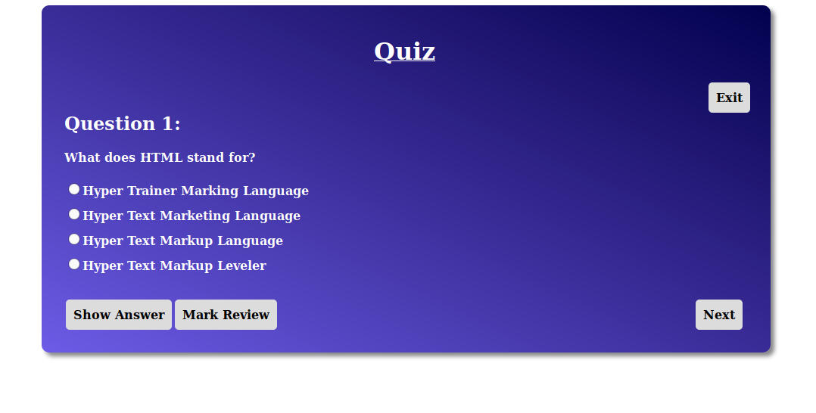
Quiz App(); Snaps

Slide 6
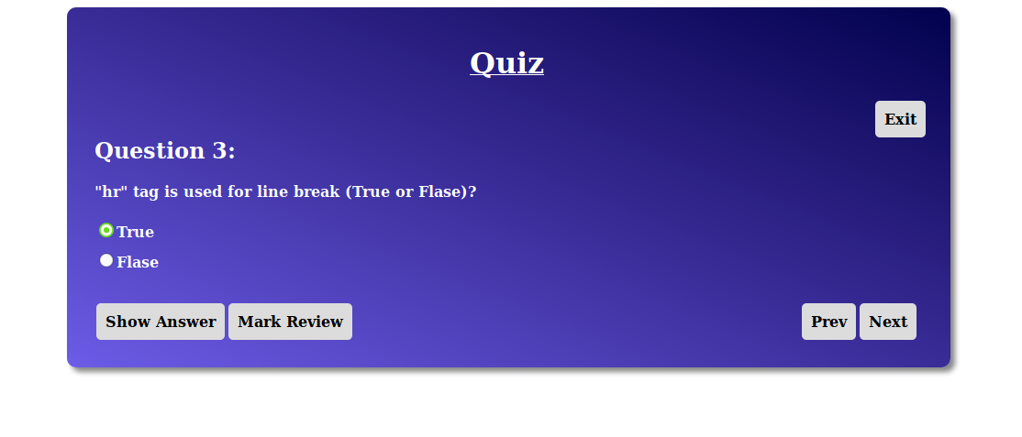
Quiz App(); Snaps

Slide 7
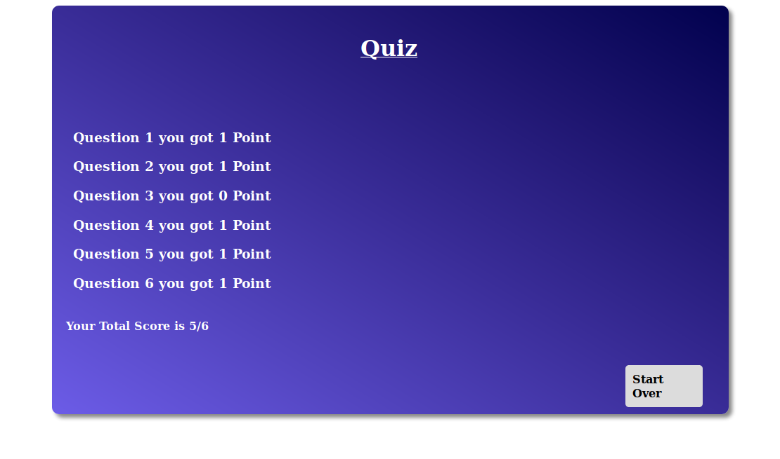
Quiz App(); Display Score

Slide 8
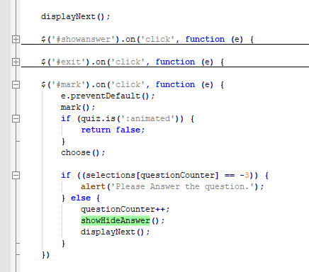
JavaScript :
Methods Used :
Array Concept
Hide()
Show()
preventDefault();
Console.log() Method to Display all the Content to the Console

Slide 9
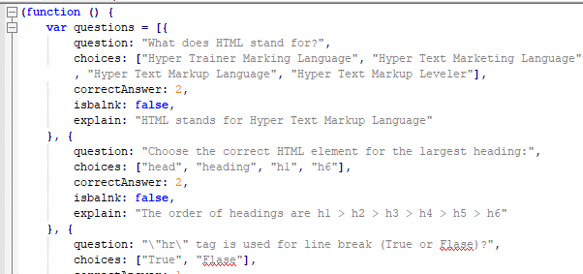
JavaScript :: JSON
JSON Used :
To Input all the questions
Declared Boolean Variables like
isBlank ;
Provided Answers in JSON with correctAnswer Variable
Included Explaination for every Questioni in the JS

Slide 10
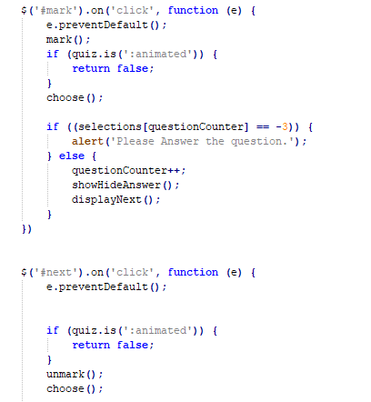
JavaScript :: BUTTONS
BUTTONS Used :
MarkReview (to Review )
ShowAnswer
Previous
Next()
Exit()
Start Over()

Slide 11
Challenges…
Very major challenge I faced is how to store the Questions data and persist it till close.
To Solve this I used JSON (JavaScript Object Notation) which is a universal data interchange format between a server and client app.
So I am able to store all the questions in JSON format in to a variable.

Slide 12
Challenges…
Storing the Selection answers
To save Selection answers I used an Array to store the answer of the each question
Index of selections matches with the index of the question

Slide 13
Challenges..
Locking the question
This is the most critical part of the app
In order to lock a question i have used another array lockQuestions with all initialized to false
So whenever a user click on the show answer i made the particular index value of lockQuestions array to true so which can be indicated as locked and so i can perform the tasks accordingly

Slide 14
Challenges…
Displaying the Score
In order to display the score I have taken all the selections from the array and compared with the answers in the questions array and calculated the total number of the correct answers and the displayed the exact result.

Slide 15
Thank you :)

